Slide 1
EXCITATION TABLE
LECTURE 6

Slide 2
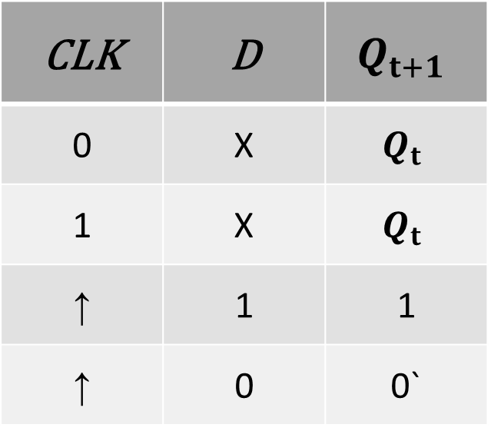
D FLIPFLOP CHARACTERISTICS TABLES
CLK | D | $$Q_{t+1}$$
0 | X | $$Q_{t}$$
1 | X | $$Q_{t}$$
↑ | 1 | 1
↑ | 0 | 0`

Slide 3
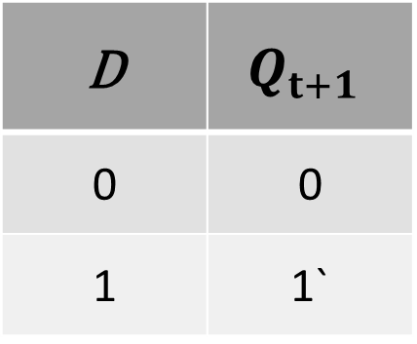
D FLIPFLOP CHARACTERISTICS TABLES
D | $$Q_{t+1}$$
0 | 0
1 | 1`

Slide 4


STATE DIAGRAM FOR D FLIP FLOP
D | $$Q_{t+1}$$
0 | 0
1 | 1`

Slide 5
STATE DIAGRAM FOR D FLIP FLOP
D | $$Q_{t+1}$$
0 | 0
1 | 1`
1

Slide 6
STATE DIAGRAM FOR D FLIP FLOP
D | $$Q_{t+1}$$
0 | 0
1 | 1`
1
0

Slide 7
STATE DIAGRAM FOR D FLIP FLOP
D | $$Q_{t+1}$$
0 | 0
1 | 1`
1
0
0

Slide 8

STATE DIAGRAM FOR D FLIP FLOP
D | $$Q_{t+1}$$
0 | 0`
1 | 1
1
0
1
0

Slide 9
STATE DIAGRAM FOR D FLIP FLOP
D | $$Q_{t+1}$$
0 | 0`
1 | 1
1
0
1
0

Slide 10
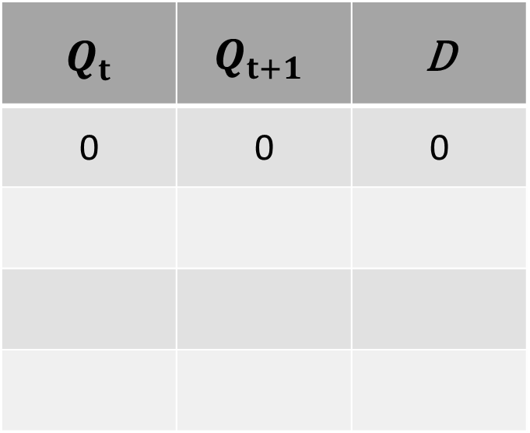
EXCITATION TABLE FROM STATE DIAGRAM FOR D FLIP FLOP
$$Q_{t}$$ | $$Q_{t+1}$$ | D
0 | 0 | 0
1
0
1
0
1
0

Slide 11
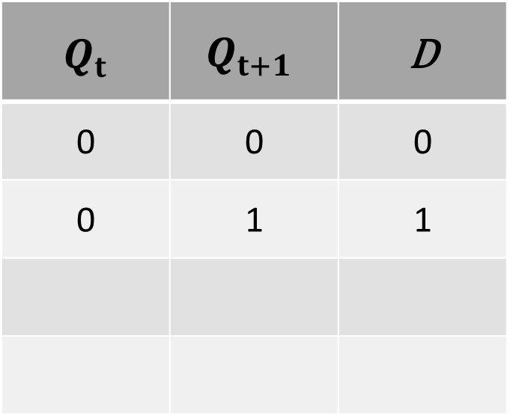
EXCITATION TABLE FROM STATE DIAGRAM FOR D FLIP FLOP
$$Q_{t}$$ | $$Q_{t+1}$$ | D
0 | 0 | 0
0 | 1 | 1
1
0
1
0
1
0

Slide 12
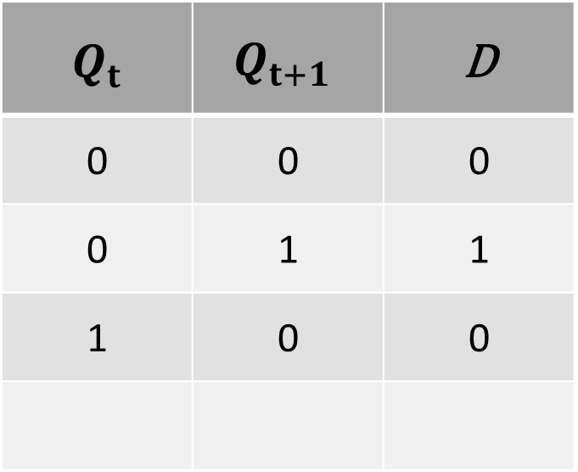
EXCITATION TABLE FROM STATE DIAGRAM FOR D FLIP FLOP
$$Q_{t}$$ | $$Q_{t+1}$$ | D
0 | 0 | 0
0 | 1 | 1
1 | 0 | 0
1
0
1
0
1
0

Slide 13
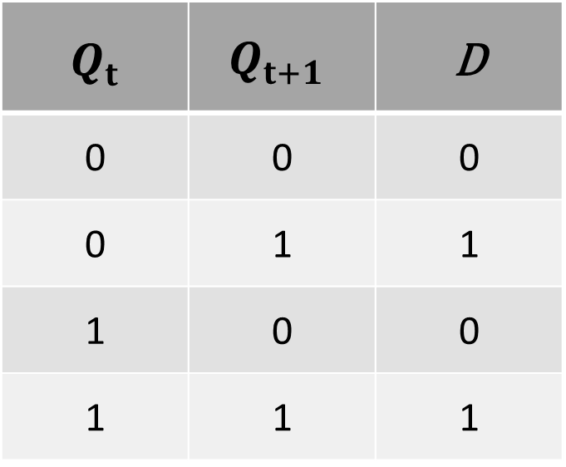
EXCITATION TABLE FROM STATE DIAGRAM FOR D FLIP FLOP
$$Q_{t}$$ | $$Q_{t+1}$$ | D
0 | 0 | 0
0 | 1 | 1
1 | 0 | 0
1 | 1 | 1
1
0
1
0
1
0

Slide 14
EXCITATION TABLE D FLIP FLOP
$$Q_{t}$$ | $$Q_{t+1}$$ | D
0 | 0 | 0
0 | 1 | 1
1 | 0 | 0
1 | 1 | 1

Slide 15
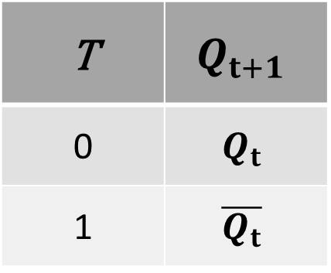
T FLIPFLOP CHARACTERISTICS TABLES
T | $$Q_{t+1}$$
0 | $$Q_{t}$$
1 | $$\overline{Q_{t}}$$

Slide 16

STATE DIAGRAM FOR T-FLIP FLOP
T | $$Q_{t+1}$$
0 | $$Q_{t}$$
1 | $$\overline{Q_{t}}$$

Slide 17
STATE DIAGRAM FOR T-FLIP FLOP
T | $$Q_{t+1}$$
0 | $$Q_{t}$$
1 | $$\overline{Q_{t}}$$
0

Slide 18
STATE DIAGRAM FOR T-FLIP FLOP
T | $$Q_{t+1}$$
0 | $$Q_{t}$$
1 | $$\overline{Q_{t}}$$
0
0

Slide 19
STATE DIAGRAM FOR T-FLIP FLOP
T | $$Q_{t+1}$$
0 | $$Q_{t}$$
1 | $$\overline{Q_{t}}$$
1
0
0

Slide 20
STATE DIAGRAM FOR T-FLIP FLOP
T | $$Q_{t+1}$$
0 | $$Q_{t}$$
1 | $$\overline{Q_{t}}$$
1
0
0
1

Slide 21
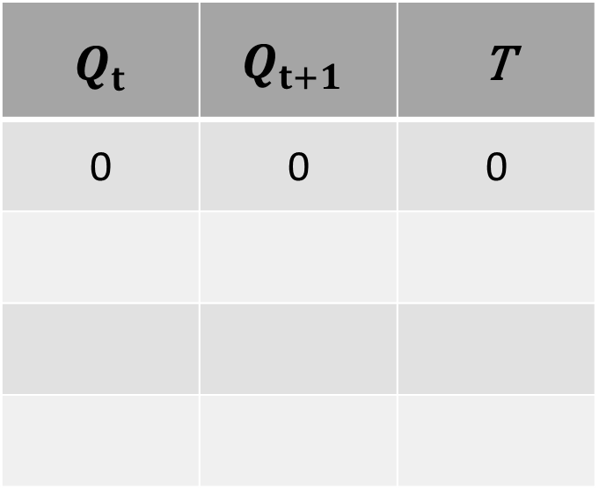
EXCITATION TABLE FROM STATE DIAGRAM FOR T FLIP FLOP
$$Q_{t}$$ | $$Q_{t+1}$$ | T
0 | 0 | 0
1
0
0
0
1
1

Slide 22
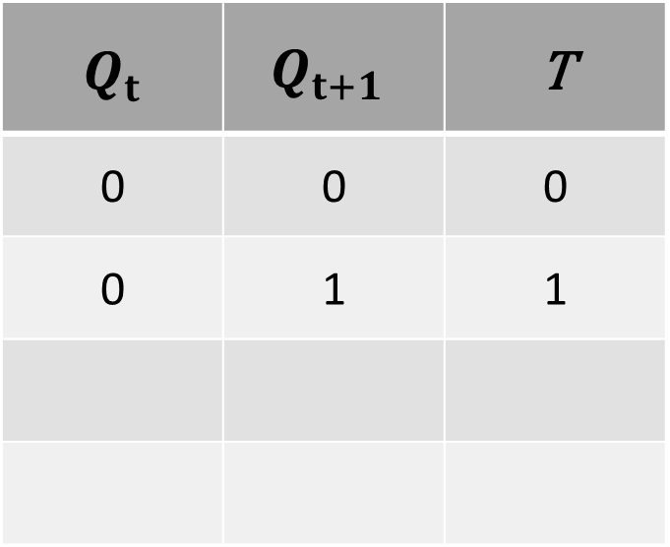
EXCITATION TABLE FROM STATE DIAGRAM FOR T FLIP FLOP
$$Q_{t}$$ | $$Q_{t+1}$$ | T
0 | 0 | 0
0 | 1 | 1
1
0
0
0
1
1

Slide 23
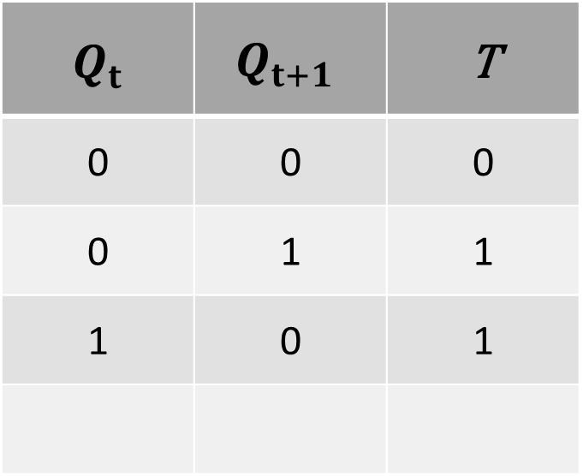
EXCITATION TABLE FROM STATE DIAGRAM FOR T FLIP FLOP
$$Q_{t}$$ | $$Q_{t+1}$$ | T
0 | 0 | 0
0 | 1 | 1
1 | 0 | 1
1
0
0
0
1
1

Slide 24
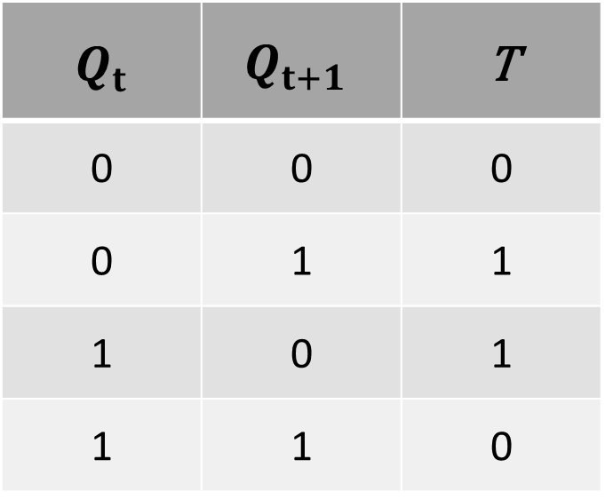
EXCITATION TABLE FROM STATE DIAGRAM FOR T FLIP FLOP
$$Q_{t}$$ | $$Q_{t+1}$$ | T
0 | 0 | 0
0 | 1 | 1
1 | 0 | 1
1 | 1 | 0
1
0
0
0
1
1

Slide 25
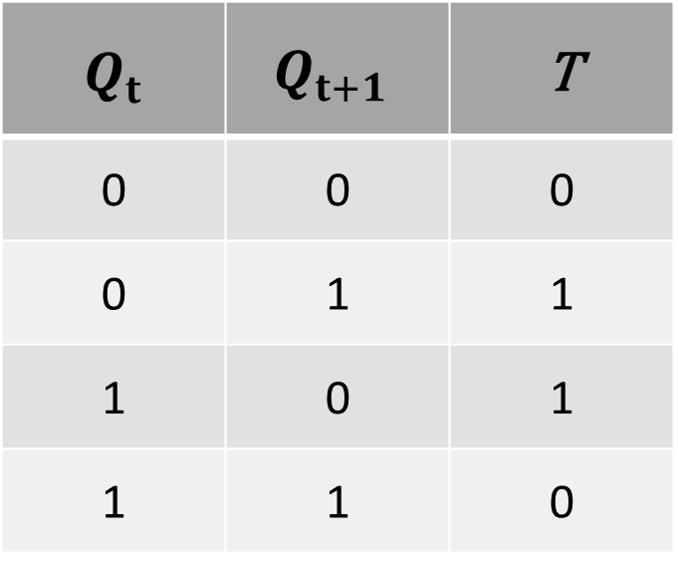
EXCITATION TABLE T FLIP FLOP
$$Q_{t}$$ | $$Q_{t+1}$$ | T
0 | 0 | 0
0 | 1 | 1
1 | 0 | 1
1 | 1 | 0

Slide 26
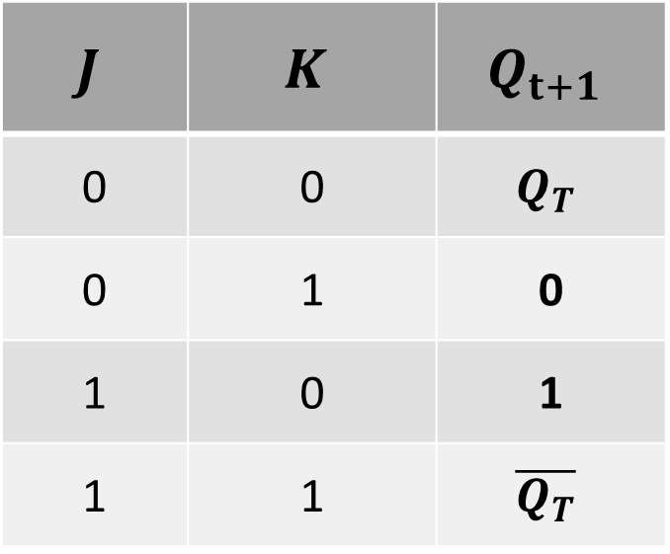
JK FLIPFLOP CHARACTERISTICS TABLES
$$J$$ | $$K$$ | $$Q_{t+1}$$
0 | 0 | $$Q_{T}$$
0 | 1 | 0
1 | 0 | 1
1 | 1 | $$\overline{Q_{T}}$$

Slide 27
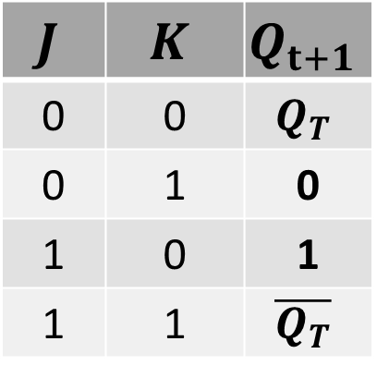
STATE DIAGRAM FOR JK-FLIP FLOP
$$J$$ | $$K$$ | $$Q_{t+1}$$
0 | 0 | $$Q_{T}$$
0 | 1 | 0
1 | 0 | 1
1 | 1 | $$\overline{Q_{T}}$$

Slide 28
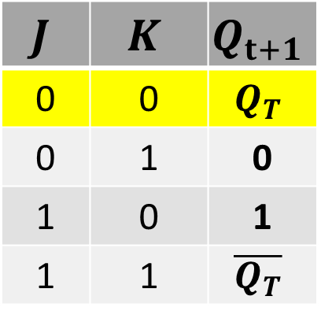
STATE DIAGRAM FOR JK-FLIP FLOP
$$J$$ | $$K$$ | $$Q_{t+1}$$
0 | 0 | $$Q_{T}$$
0 | 1 | 0
1 | 0 | 1
1 | 1 | $$\overline{Q_{T}}$$
JK00

Slide 29
STATE DIAGRAM FOR JK-FLIP FLOP
$$J$$ | $$K$$ | $$Q_{t+1}$$
0 | 0 | $$Q_{T}$$
0 | 1 | 0
1 | 0 | 1
1 | 1 | $$\overline{Q_{T}}$$
JK00
JK00

Slide 30
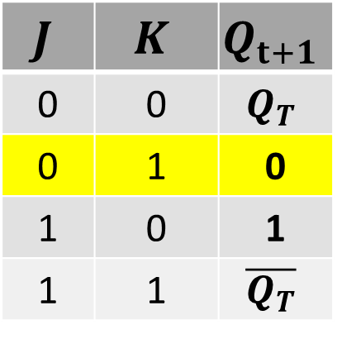
STATE DIAGRAM FOR JK-FLIP FLOP
$$J$$ | $$K$$ | $$Q_{t+1}$$
0 | 0 | $$Q_{T}$$
0 | 1 | 0
1 | 0 | 1
1 | 1 | $$\overline{Q_{T}}$$
JK00
JK00
JK01

Slide 31
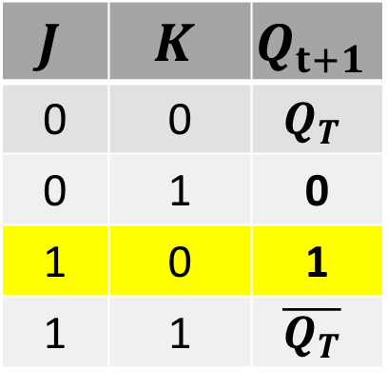
STATE DIAGRAM FOR JK-FLIP FLOP
$$J$$ | $$K$$ | $$Q_{t+1}$$
0 | 0 | $$Q_{T}$$
0 | 1 | 0
1 | 0 | 1
1 | 1 | $$\overline{Q_{T}}$$
JK00
JK00
JK01
JK10

Slide 32
STATE DIAGRAM FOR JK-FLIP FLOP
$$J$$ | $$K$$ | $$Q_{t+1}$$
0 | 0 | $$Q_{T}$$
0 | 1 | 0
1 | 0 | 1
1 | 1 | $$\overline{Q_{T}}$$
JK00
JK00
JK01
JK10

Slide 33

STATE DIAGRAM FOR JK-FLIP FLOP
$$J$$ | $$K$$ | $$Q_{t+1}$$
0 | 0 | $$Q_{T}$$
0 | 1 | 0
1 | 0 | 1
1 | 1 | $$\overline{Q_{T}}$$
JK0X
JKX0

Slide 34
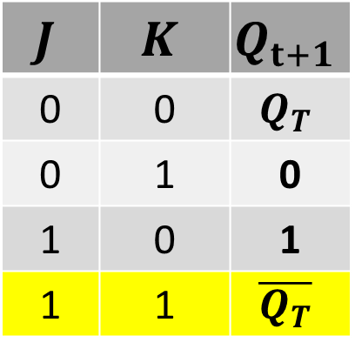
STATE DIAGRAM FOR JK-FLIP FLOP
$$J$$ | $$K$$ | $$Q_{t+1}$$
0 | 0 | $$Q_{T}$$
0 | 1 | 0
1 | 0 | 1
1 | 1 | $$\overline{Q_{T}}$$
JK0X
JK11
JKX0

Slide 35
STATE DIAGRAM FOR JK-FLIP FLOP
$$J$$ | $$K$$ | $$Q_{t+1}$$
0 | 0 | $$Q_{T}$$
0 | 1 | 0
1 | 0 | 1
1 | 1 | $$\overline{Q_{T}}$$
JK10
JK11
JKX0
JK0X

Slide 36
STATE DIAGRAM FOR JK-FLIP FLOP
$$J$$ | $$K$$ | $$Q_{t+1}$$
0 | 0 | $$Q_{T}$$
0 | 1 | 0
1 | 0 | 1
1 | 1 | $$\overline{Q_{T}}$$
JK11
JK10
JKX0
JK0X

Slide 37
STATE DIAGRAM FOR JK-FLIP FLOP
$$J$$ | $$K$$ | $$Q_{t+1}$$
0 | 0 | $$Q_{T}$$
0 | 1 | 0
1 | 0 | 1
1 | 1 | $$\overline{Q_{T}}$$
JK1X
JKX0
JK0X

Slide 38
STATE DIAGRAM FOR JK-FLIP FLOP
$$J$$ | $$K$$ | $$Q_{t+1}$$
0 | 0 | $$Q_{T}$$
0 | 1 | 0
1 | 0 | 1
1 | 1 | $$\overline{Q_{T}}$$
JK1X
JKX0
JK0X
JK11

Slide 39
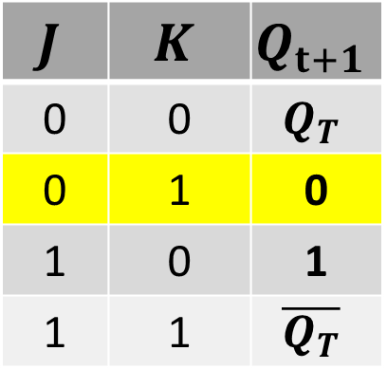
STATE DIAGRAM FOR JK-FLIP FLOP
$$J$$ | $$K$$ | $$Q_{t+1}$$
0 | 0 | $$Q_{T}$$
0 | 1 | 0
1 | 0 | 1
1 | 1 | $$\overline{Q_{T}}$$
JK1X
JKX0
JK0X
JK11
JK01

Slide 40
STATE DIAGRAM FOR JK-FLIP FLOP
$$J$$ | $$K$$ | $$Q_{t+1}$$
0 | 0 | $$Q_{T}$$
0 | 1 | 0
1 | 0 | 1
1 | 1 | $$\overline{Q_{T}}$$
JK1X
JKX0
JK0X
JK11
JK01

Slide 41
STATE DIAGRAM FOR JK-FLIP FLOP
$$J$$ | $$K$$ | $$Q_{t+1}$$
0 | 0 | $$Q_{T}$$
0 | 1 | 0
1 | 0 | 1
1 | 1 | $$\overline{Q_{T}}$$
JK1X
JKX0
JK0X
JKX1

Slide 42
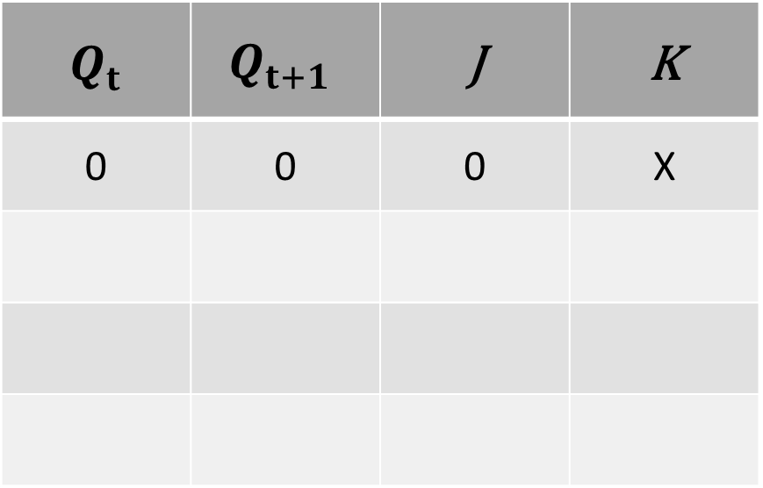
EXCITATION TABLE FROM STATE DIAGRAM FOR JK FLIP FLOP
$$Q_{t}$$ | $$Q_{t+1}$$ | J | K
0 | 0 | 0 | X
JK
1X
JK
0X
JK
X0
JK
X1

Slide 43
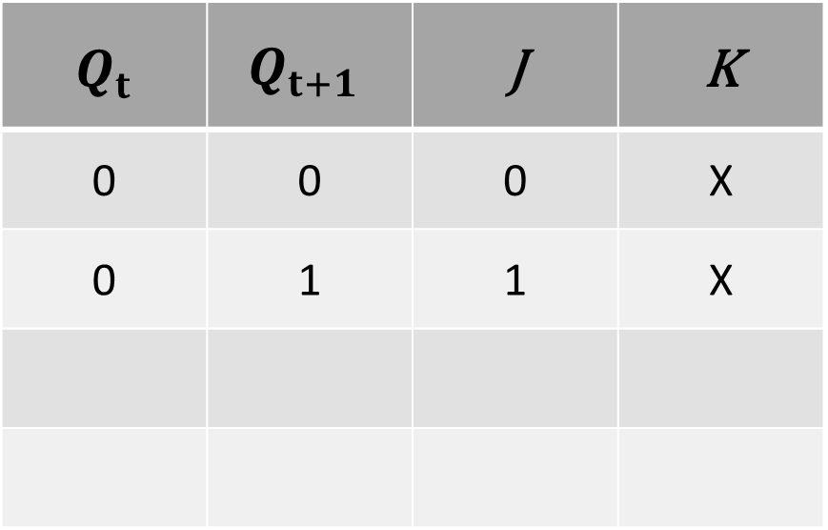
EXCITATION TABLE FROM STATE DIAGRAM FOR JK FLIP FLOP
$$Q_{t}$$ | $$Q_{t+1}$$ | J | K
0 | 0 | 0 | X
0 | 1 | 1 | X
JK
1X
JK
0X
JK
X0
JK
X1

Slide 44
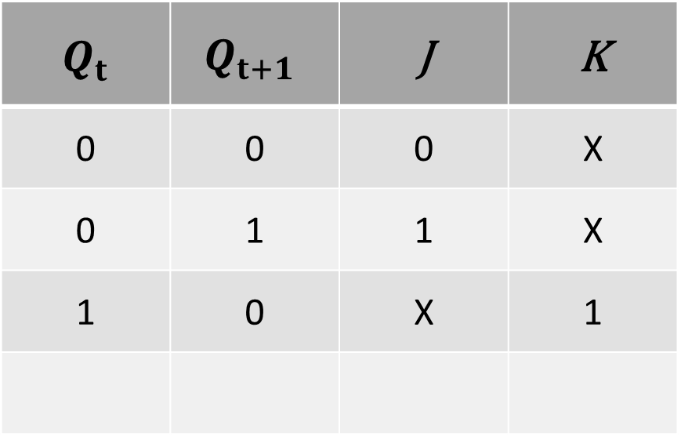
EXCITATION TABLE FROM STATE DIAGRAM FOR JK FLIP FLOP
$$Q_{t}$$ | $$Q_{t+1}$$ | J | K
0 | 0 | 0 | X
0 | 1 | 1 | X
1 | 0 | X | 1
JK
1X
JK
0X
JK
X0
JK
X1

Slide 45
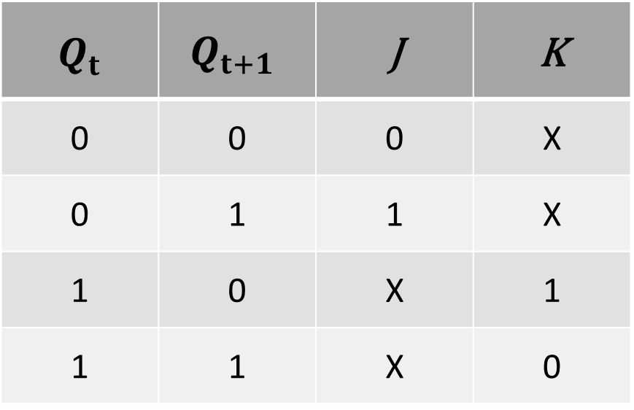
EXCITATION TABLE FROM STATE DIAGRAM FOR JK FLIP FLOP
$$Q_{t}$$ | $$Q_{t+1}$$ | J | K
0 | 0 | 0 | X
0 | 1 | 1 | X
1 | 0 | X | 1
1 | 1 | X | 0
JK
1X
JK
0X
JK
X0
JK
X1

Slide 46
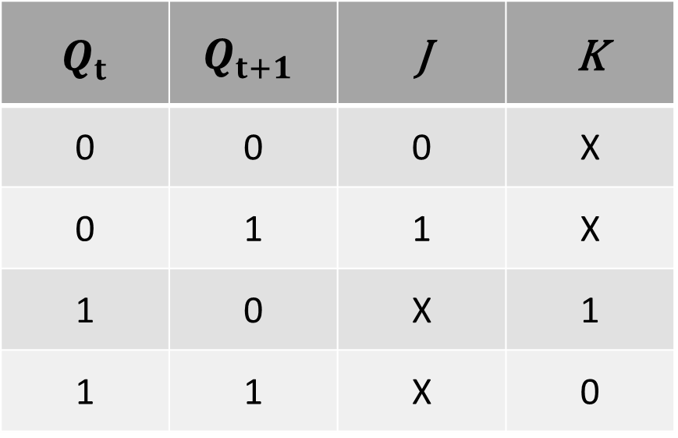
EXCITATION TABLE FOR JK FLIP FLOP
$$Q_{t}$$ | $$Q_{t+1}$$ | J | K
0 | 0 | 0 | X
0 | 1 | 1 | X
1 | 0 | X | 1
1 | 1 | X | 0

